Slide 1
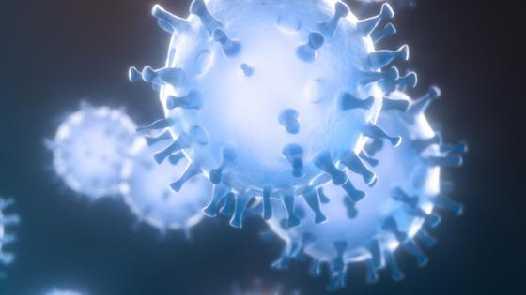
Coronavirus & Air pollution in Italy
Agnihotri, Lokesh L.K.
Amelsfoort, Britt B.S
Baciu, Alina A.
Haruna, Faith F.I.
Nowak Janssen, Daniel D.
Semester Project Group D

Slide 2
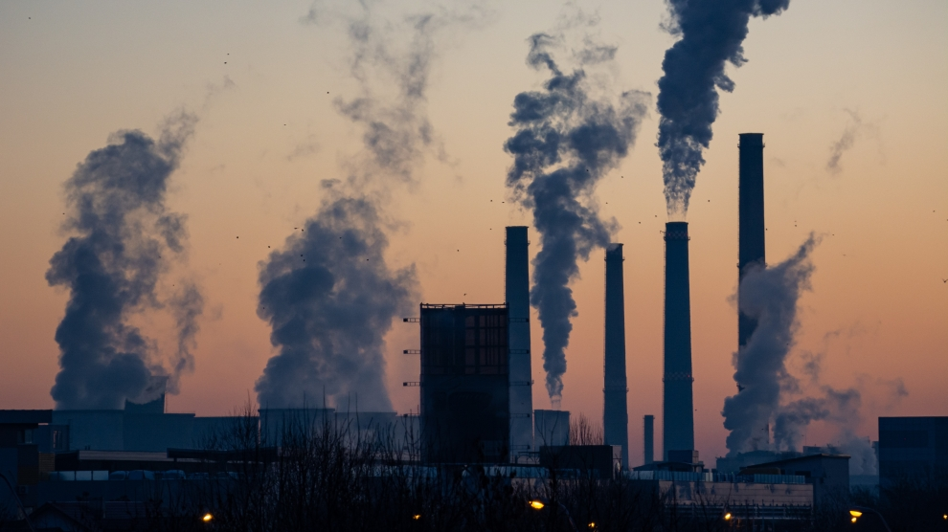
Why coronavirus?
Why Italy?
Why air pollution in Italy?
Correlation between Corona and Air pollution

Slide 3
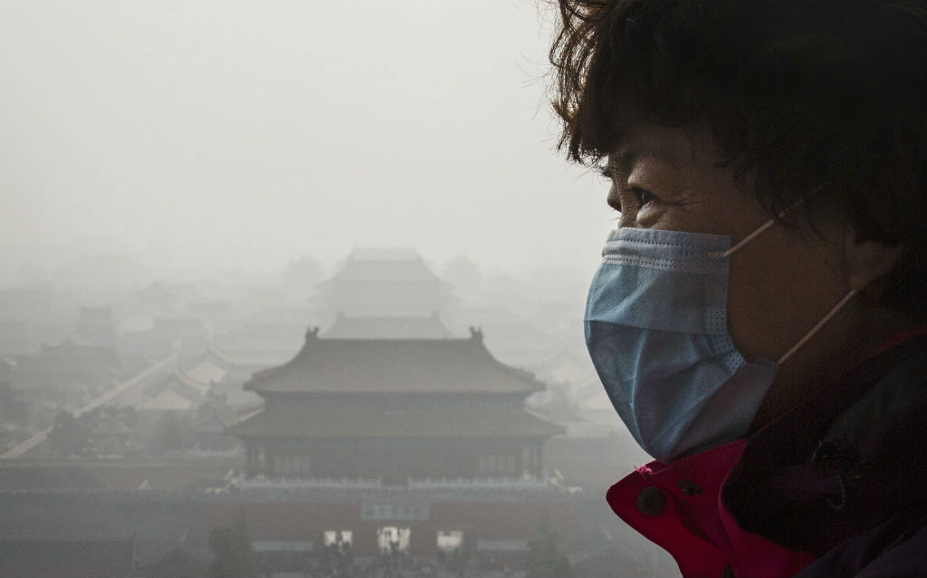
Main question
Will the number of deaths caused by pollution
be reduced because of corona?

Slide 4
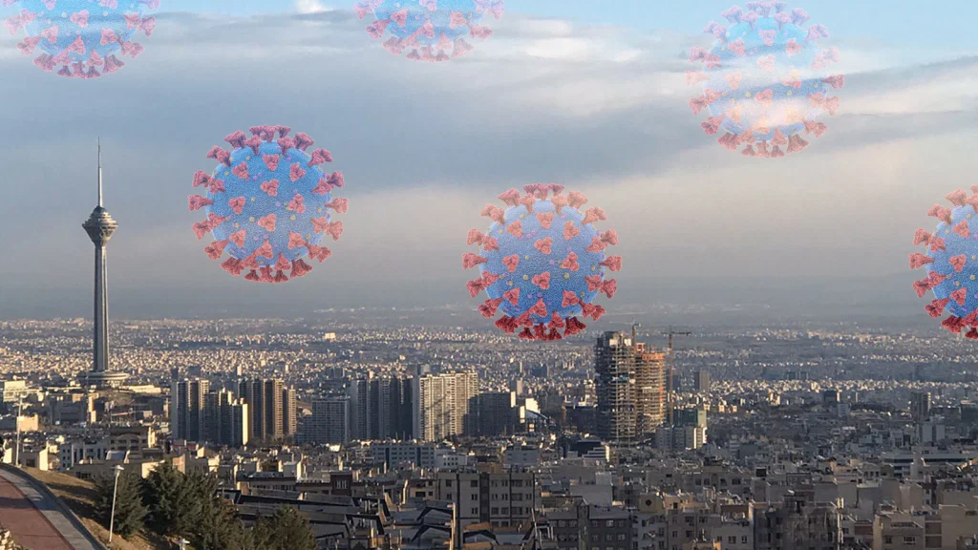
Why Italy?
Most numbers of deaths.

Slide 5
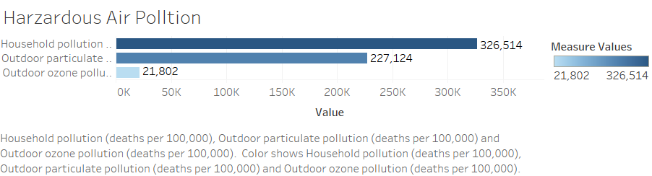

Slide 6
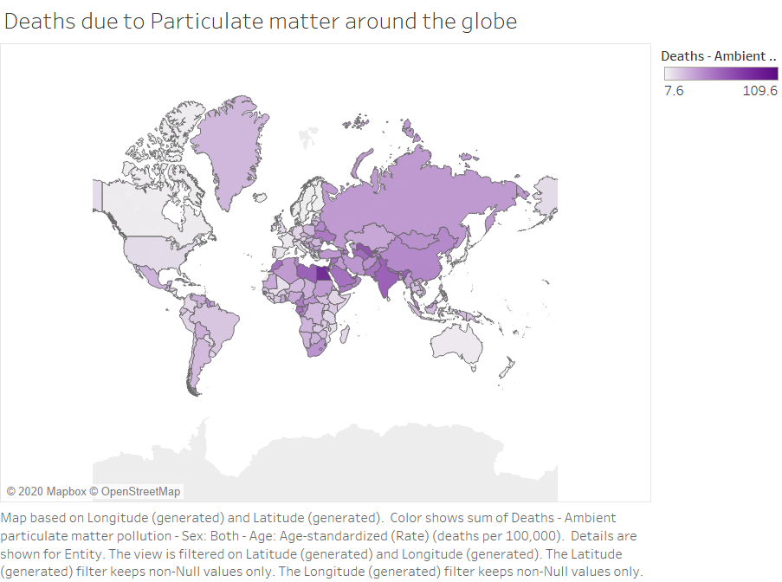

Slide 7
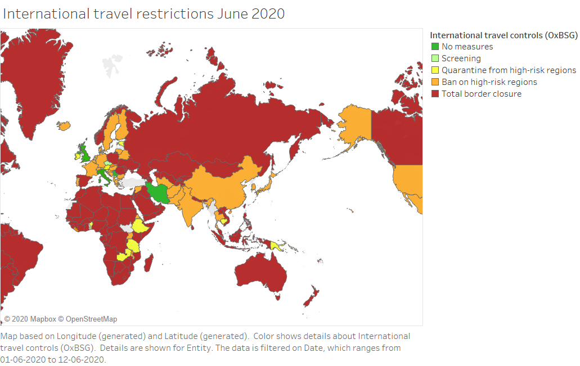

Slide 8
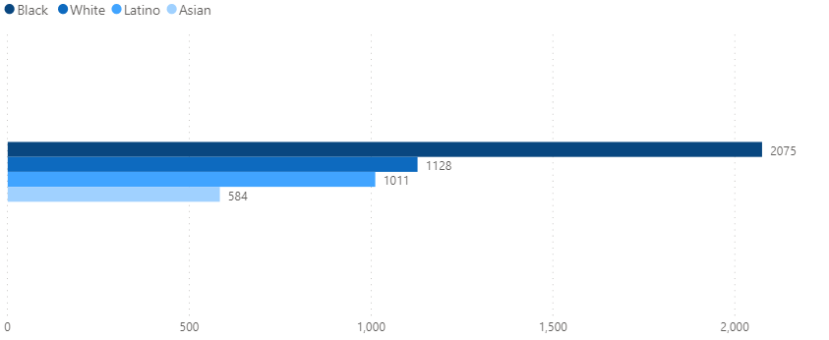
Covid-19 Deaths By Race
COVID-19 DEATHS PER 100,000 PEOPLE OF EACH GROUP, THROUGH JUNE 9, 2020

Slide 9
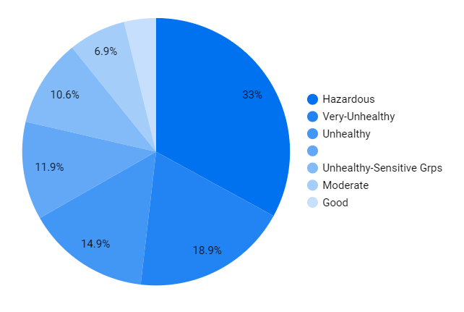
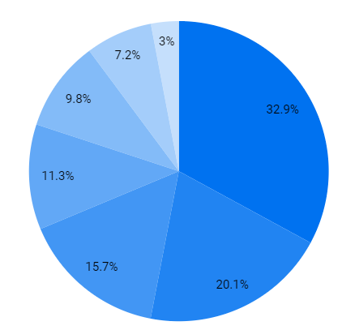
Air Pollution 2020 vs 2019
2020
2019
4.2%
Year 2020 data shows a drop of 1.2 % of unhealthy Air pollution

Slide 10
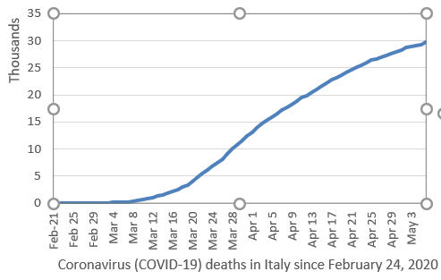
Deaths due to Coronavirus in Italy
Deaths have increased exponentially.
February was the month with least number of deaths.
Approx. 30,000 premature deaths due to Coronavirus

Slide 11
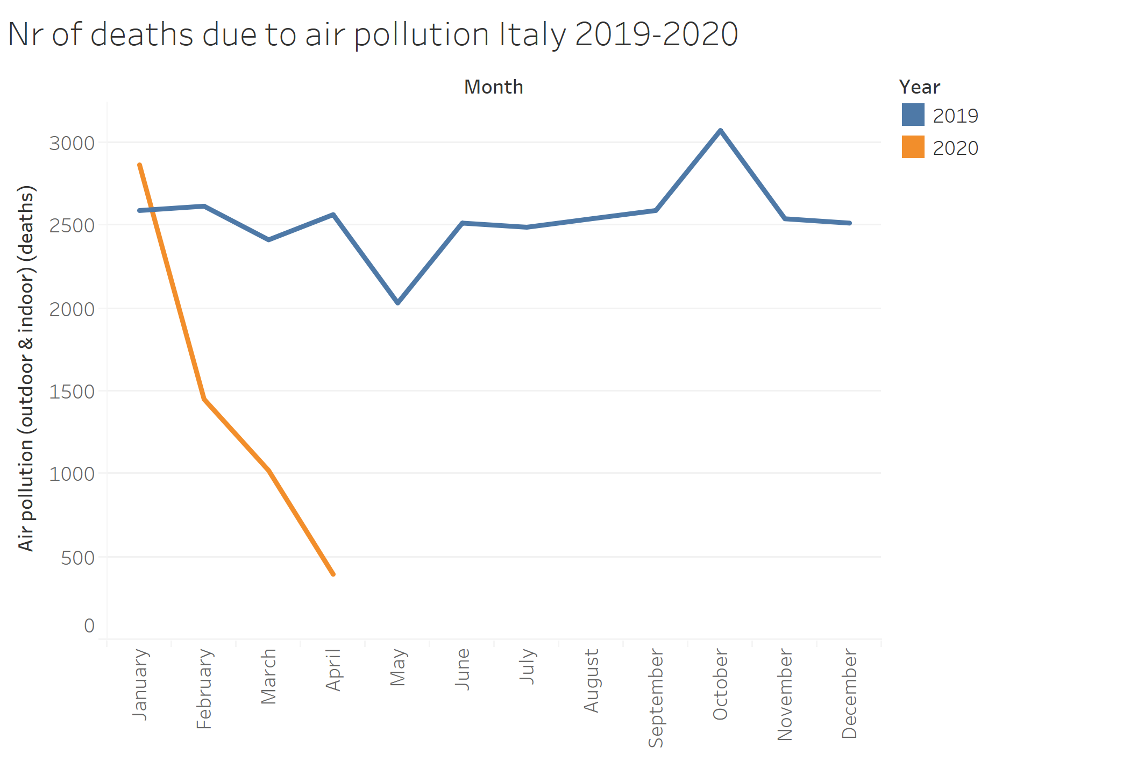
January saw a lot of premature deaths in 2019 and 2020.
With the lockdown there was a steep decrease in 2020.
We can see a continuous decrease in premature deaths probably due to less pollution.

Slide 12
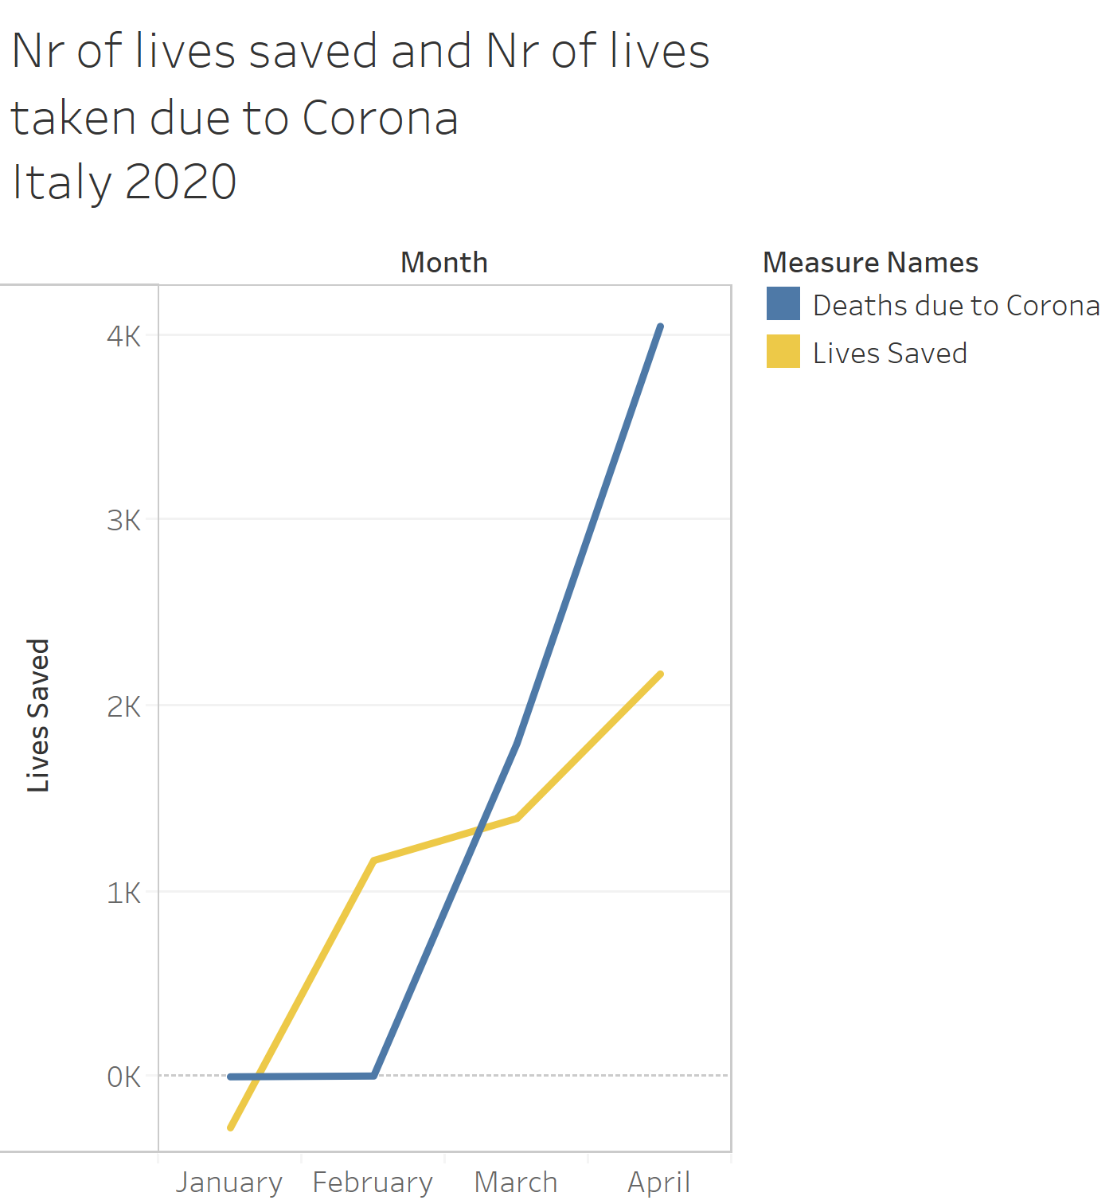
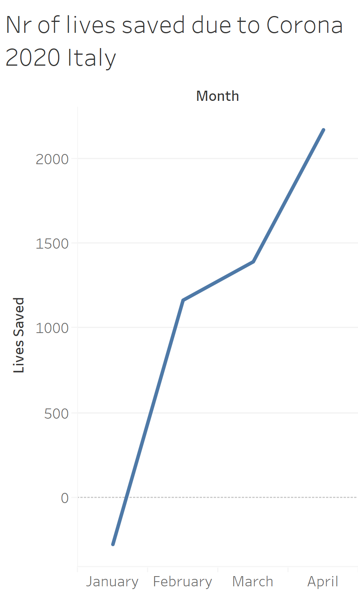
Yellow line shows premature deaths avoided due to less Air pollution.
Till April about 28 thousand premature deaths were recorded due to coronavirus
Till April about 2100 lives were saved due to less pollution level

Slide 13
Conclusion
Corona did end up taking more lives than it saved.
But it also showed us that we needed a global pandemic to see the impact of our emission, we need to tackle both covid-19 and air pollution before it's too late.

